Slide 1
PAP SMEAR
Presented by,
Mrs. R.P. Russlin Preetha, B.Sc (N)
Nursing Tutor,
Annammal College Of Nursing, Kuzhithurai

Slide 2
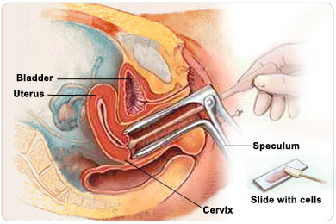

Slide 3
INDICATION
Who have had a hysterectomy
A pap smear should be performed annually or more frequently in women with a history of dysplasia.
A woman aged between 25 and 69 years old who ever have had sex are advised to have a Pap smear done once every 3 years.

Slide 4
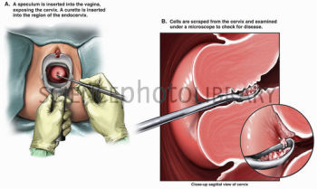

Slide 5
Preparation for Pap smear
Schedule your appointment 2 weeks after the start of your menstrual period
Avoid sexual intercourse 48 hours before the test
Do not use spermicides, vaginal creams, lubricant jellies, vaginal medications or tampons two days before the test.
Wear a two piece outfit as you would need to undress from waist down.

Slide 6
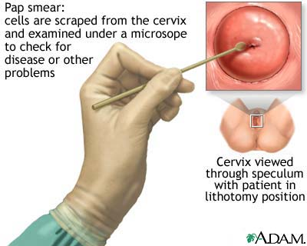

Slide 7
EQUIPMENTS
Vaginal Speculum
Gloves
Slides
Spatula

Slide 9
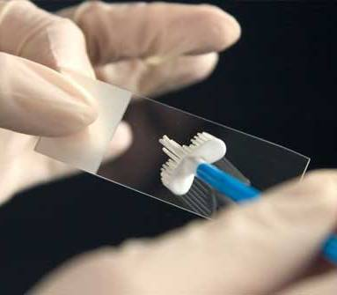

Slide 10
Pap smear test
The Pap smear test is a quick and simple test. First, you will be asked to lie down.
A small instrument called a speculum will be inserted into your vagina to get a clear view of your cervix (neck of the womb).
The nurse or doctor will then use a small brush to collect some cells from your cervix and smear them onto a glass slide.
The cell sample will be sent to the laboratory for tests.
You may experience some discomfort during the procedure.
To help you relax, take slow deep breaths as the speculum is inserted. If you feel pain, inform the doctor or nurse immediately.

Slide 11
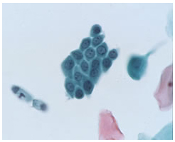
Normal cervical cells under the microscope

Slide 12
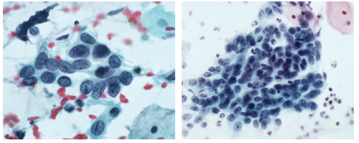
Abnormal Cervical Cells Under The Microscope

Slide 13
THANK YOU

