Slide 1
PATIENT POSITIONING DURING SURGERY
Presented by,
Mrs. R.P. Russlin Preetha, B.Sc (N)
Nursing Tutor,
Annammal College Of Nursing, Kuzhithurai

Slide 2
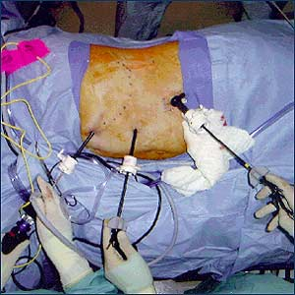
PATIENT POSITIONING DURING SURGERY

Slide 3
Positioning the patient for surgery is one of the most important procedures performed in the OT.
Positioning the patient in the appropriate position according to the type of surgery.

Slide 4
Thus a patient posted for a surgery must be placed in the required position which may be dictated by :
Type of anesthesia to be given.
Type of surgery.
Surgeons preference.
Patient safety.

Slide 5
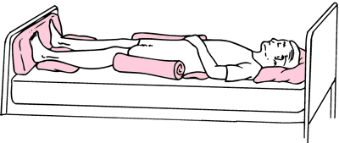
SUPINE POSITION (HORIZONTAL RECUMBENT POSITION)

Slide 6
It is frequently used positions.
In this position patient lies on his back with arms on arm boards parallel to the body.
Hands should be placed in supination (palm up).
Padding under elbow may be placed.
The arms should be tucked in tightly making sure that the IV lines and SaO2 probe are securely placed on the sites.
This position may exert pressure on heels and forearms.

Slide 7
Uses of supine position
This position is used for laparotomy, herniorrhaphy, chest and breast, facial and frontal cranial organs.
Used for upper and lower limb surgeries.
Used for physical examination before the surgery.
Is easy to achieve and is most comfortable for patient as well as the operating team.

Slide 8
Procedure
Make sure that the operating table is parallel to the floor.
Place the patient flat on his back , his knees over the lower break of the table ,feet slightly a part. The soles of the feet are supported by a foam rubber support or a padded foot board.
Place the patients arms and hands at hi sides. His elbows should be slightly flexed and his fingers extended.
Secure his hands and arms with the lift sheet.

Slide 9
Place the leg strap at the distal third of his thighs, about 2inches proximal to his knees. Fasten the leg strap enough to secure his legs, but not tight enough to constrict circulation.
In order to prevent post-operative discomfort, flex the table slightly at both breaks or place a rolled towel or small pillow under the knees. This padding should be very soft and should not make the strap too tight.

Slide 10
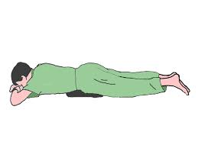
PRONE POSITION

Slide 11
This position is used in condition where the surgery is to be performed on the backside of the body such as the spine.
This position involves making the patent to lie on his abdomen with the face down and head straight forward. The arms are tucked similar to the supine position but are abducted.

Slide 12
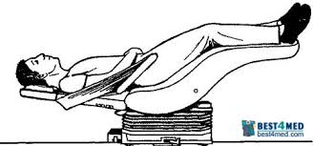
TRENDELENBURG POSITION

Slide 13
It is used for abdominal surgery, operations on the bladder , prostate gland, colon, female reproductive system, or for any operation in abdominal viscera away from the pelvic area for better exposure.

Slide 14
Procedure
Place the patient in the supine position and adjust the mattress that his knee joints are directly over the lower break. The knees must bend where the table breaks to prevent pressure on blood vessel sand nerves in the popliteal region, avoiding complications of phlebitis or paralysis of the leg.
Attach well padded shoulder braces to the table. Check to see that the braces are the same distance from the head of the table.

Slide 15
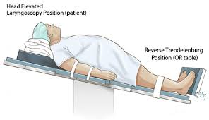
REVERSE TRENDELENBURG POSITION

Slide 16
Uses
Used for neck surgery such as thyroidectomy and abdominal surgery such as liver or gall bladder operations.

Slide 17
Procedure
Place the patient flat on his back. Adjust the mattress so that his shoulders are at the upper break of the table. If surgery is in the neck area, place a small pillow or a folded sheet transversely under the neck and shoulders.
Attach the padded foot board at a 90 degree angle to the table and adjust it so that the soles of the feet are resting it. Place padding under the legs to take pressure off the heels.

Slide 18
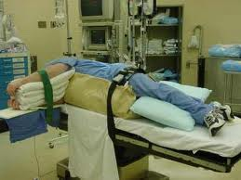
LATERAL KIDNEY POSITION

Slide 19
Uses
It is used for surgery on the kidney or the proximal third of the ureter.

Slide 20
Right kidney position: procedure
Turn the patient onto his unaffected side and bring his back near the edge of the table. Then BP is monitored before proceeding further.
Manipulate the mattress as necessary until the patients kidney area is over the body elevator of the table.
Flex the lower leg on the unaffected side at the knee, extend the upper leg on the affected side and place a pillow lengthwise between the legs. Also, place padding under the leg in contact with the table at the sites of bony prominences.

Slide 21
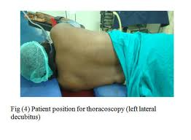
LATERAL CHEST POSITION

Slide 22
Uses
It is used for thoracoplasty, pneumonectomy and lobectomy.

Slide 23
Right lateral position: procedure
Place the patient on his unaffected side with his back near the edge of the table. This requires 2 people; the anesthetist managing the head and shoulders and the assistant moving the hips.
Place the upper leg straight with the patients body and flex the leg on the lower side. Place a pillow lengthwise between the legs.
Place a folded sheet or a small hard pillow under the patient.
Place a chest rest near the lumbar area and another at the level of the axilla.

Slide 24
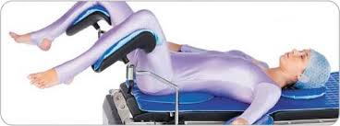
LITHOTOMY POSITION

Slide 25
The patient is on his back with the foot section on the table lowered to a right angle with the body of the table.
Knees are flexed and the legs are on the outside of the metal posts with the feet supported by canvas straps.
The buttocks are even with the table edge.

Slide 26
Uses
It is used for surgery in the perineal area, such as drainage of rectal abscesses and perineal prostatectomy's, and for gynecological surgery such as vaginal hysterectomy.

Slide 27
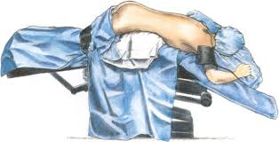
JACKNIFE (KRASKE) POSITION

Slide 28
Uses
It is used for surgery on the coccyx, buttocks or rectum.

Slide 29
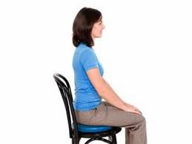
SITTING POSITION

Slide 30
Uses
It is used for nose, throat and plastic surgical procedure.

Slide 31
THANK YOU

